Slide 1

INFO 5707 Data Modeling for Information Professionals
Hospital Database
Aishni Renu Salla
Saipallavi Panga
Venkata Sri Ambica Mokarala

Slide 2

Description
Hospitals play a crucial role in our lives, working to offer the best medical care to those who are ill with a variety of diseases due to changes in climatic conditions, increasing workloads, emotional trauma, and stress.
The hospital finds it extremely challenging to manually keep all its daily activities and records. Because of this, a database is necessary to keep track of all hospital activities.
A hospital or other medical facility's operation can be managed via a computerized or web-based system called a hospital database management system.

Slide 3

Objectives
The main objective of hospital database is that it will contribute to a paperless workplace by digitizing all patient information and hospital information.
Making the patient's appointment with the doctor convenient for both parties.
Scope
The Hospital Database System is used to collect patient information and save it for future purposes, used in all hospitals, clinics, dispensaries, and pathology labs.
The system's goals are to decrease overtime pay and boost the percentage of patients who can receive precise care.

Slide 4

User requirements
The database can be accessed by the doctors and hospital staff. Doctors can access data about patient details such as disease, treatment, prescription drugs etc.
Apart from patient health records, the database also records patient identification numbers, names, addresses, dates of admission, doctors' names, and room numbers are entered on a form and saved for later use, also the database ensures to protect patient privacy and confidentiality by providing access to only authorized members.
Additionally, physicians can easily access specific patient information with the patient id parameter.

Slide 5
Entities and Attributes
1. Patient
2.Doctor
3.Nurse
4.Visitor
Patient
Patient ID
First_name
Last_name
Address_ID
DoctorID
DiseaseID
RoomID
Phone
NurseID
VistorID
Insurance
Date of Birth
Doctor
DoctorID
Doc_first name
Doc_last name
Department
Patient ID
Nurse
NurseID
Nur_first name
Nur_last name
Department
Patient ID
Visitor
VisitorID
Vis_first name
Vis_last name
Relation
Visit_time
Patient ID

Slide 6
Entities and Attributes
6.Room
7. Address
5. Disease
Disease
DiseaseID
Disease_name
Treatment
Prescription_by
Drugs
Doctor_ID
Room
RoomID
Room_num
Building
Block
PatientID
Address
AddressID
Street_name
County
State
Country
Zipcode
Patient ID

Slide 7

Business rules
One patient can have one doctor (one to one)
One doctor can have many patients (one to many)
One patient can be allotted one room (one to one)
One room can have many patients (One to many)
Each patient can have more than one disease but at least one
Same disease can be for different patients (One to many)
One patient can have one address (One to one)
One address can be for one or many patients (One to many)
One patient can have one nurse (One to one)
One nurse can handle different patients (One to many)
One patient has many visitors (One to many)
One visitor is only for one person (one to one)

Slide 8
Data Dictionary
Patient Table | Term | Description
Patient Table | First_name | First name of the patient
 | Last_name | Last name of the patient
 | Phone
 | Insurance
 | Date_of_birth
Doctor Table | Term | Description
Doctor Table | Doc_firstname | First name of the doctor
 | Doc_lastname | Last name of the doctor
 | Department | Department to which the doctor belongs
Nurse table | Term | Description
Nurse table | Nur_firstname | First name of the attending nurse
 | Nur_lastname | Last name of the attending nurse

Slide 9
Visitor table | Terms | Description
Visitor table | Vis_firstname | First name of the visitor
 | Vis_lastname: | Last name of the visitor
 | Relation: | Visitors’ relation to the patient
 | Visit_time: | Time of visitation
Disease table | Terms | Description
Disease table | Treatment | Treatment for the disease by doctor
 | Prescription_by | Person/doctor who prescribed the drug/treatment
Room Table | Terms | Description
Room Table | Room_num
 | building
 | Block

Slide 10
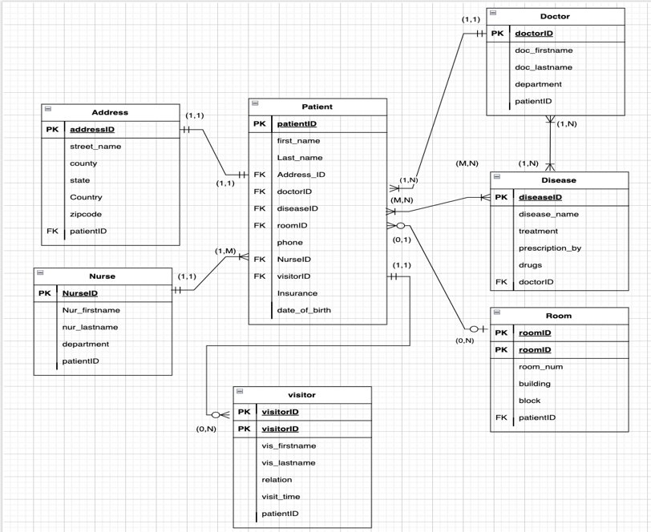
ERD

Slide 11

THANK YOU

